Slide 1

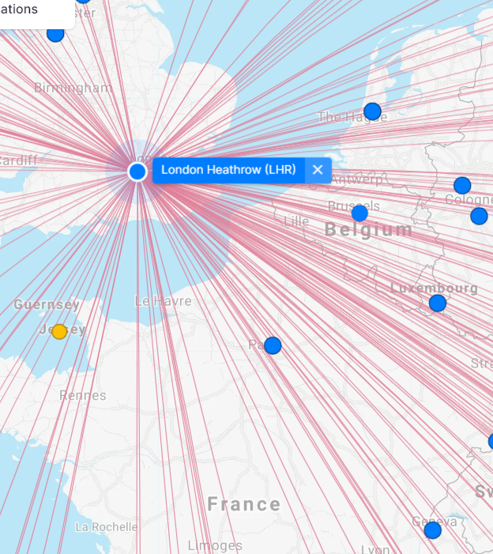
Flight Planner
Main Objective
Provide travel agencies with the ability to retrieve and update data for end-to-end journeys

Slide 2


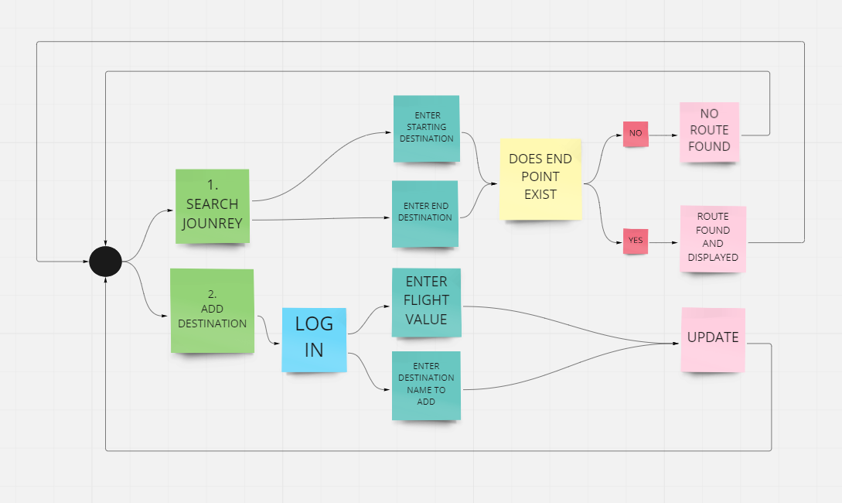
Main Flow

Slide 3

User enters initial and final destination to receive visual representation of the travel journey including transfers if required
New destinations can be added which keeps the application up to date
All the data is dynamically loaded to Linked Lists via local file containing all journeys

Slide 4
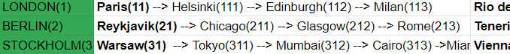
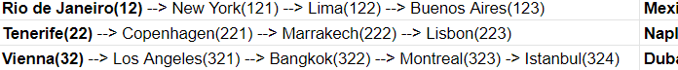
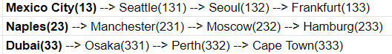
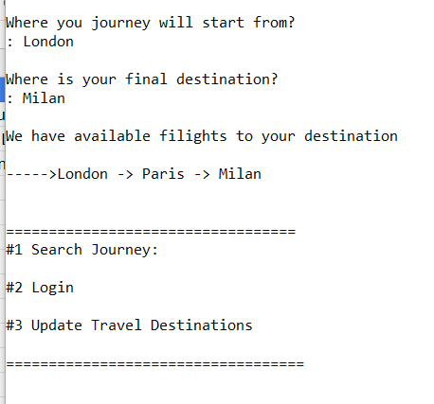
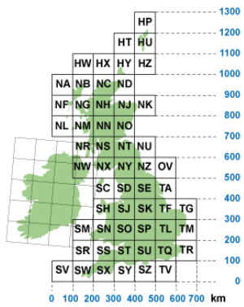
All destinations are also encoded which provides quick identification and access by mapping numerical and alphabetical data.

Slide 5

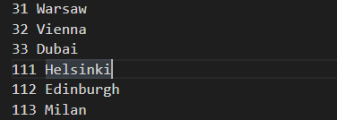
Using modulo and division to split the code to 1’s, 10’s and 100’s allows to:
quickly identify each airport node position
travers the list to the exact node, when populating or retrieving data.

Slide 6

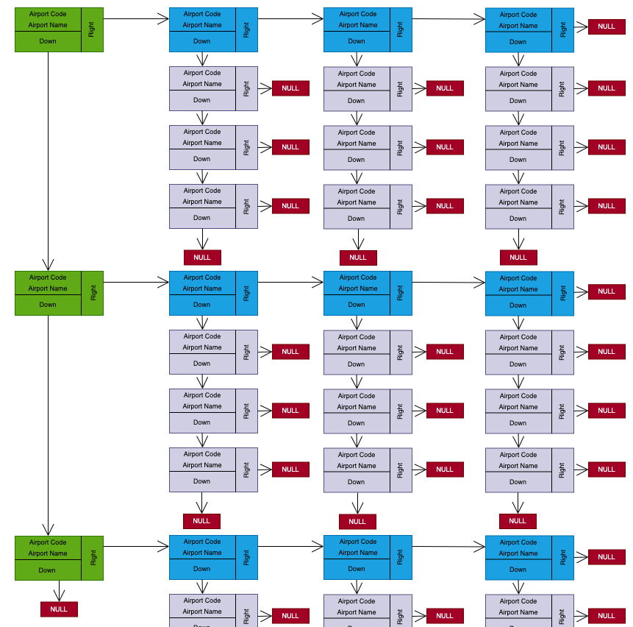
There are main linked list nodes which represent the starting point of each route.
These nodes are linked to their direct access destinations (no transfers required).
The direct destinations are linked to sub-destinations

Slide 7

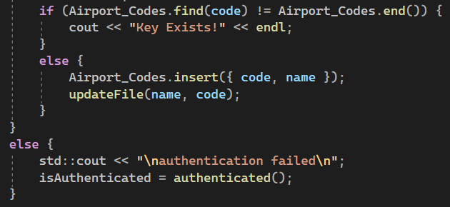
After authenticating, user is allowed to input new data and update the system

Slide 8
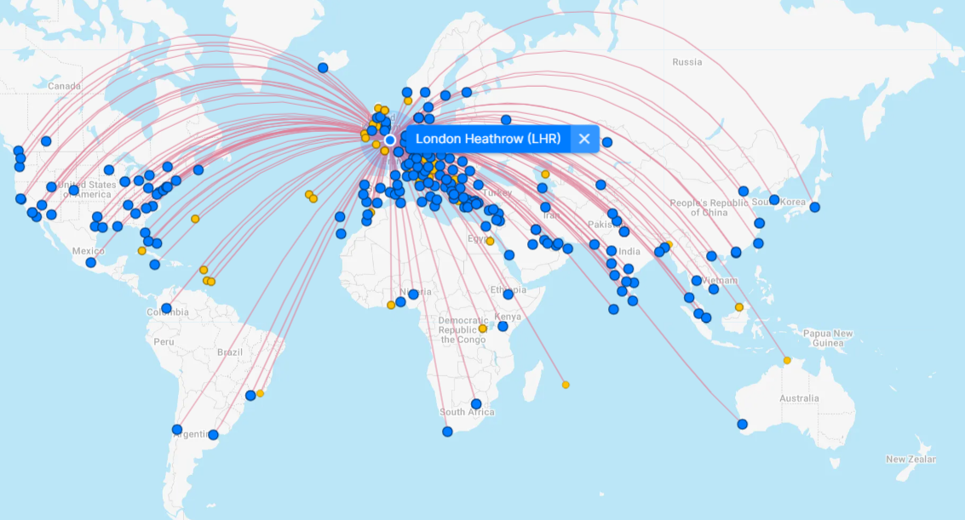
by
Rachel Locke
Gurpal Gohler
Deyan Petkov

